Slide 1

Foundations of Data Science Assignment
21BDS0153 – Varshith N

Slide 2

Links for csv and jupyter notebook
ipynb:-
https://colab.research.google.com/drive/15nlPYY8uTB3ovAlC3fcZBT1bB7wEtSLH?usp=sharing
csv file :-
https://docs.google.com/spreadsheets/d/1Wb0LNUOFUY3xeRK4wKSrx-kwmLYRdl8pnRTnaqRRLvc/edit?usp=sharing

Slide 3
Project Background
Heart disease is a significant public health concern worldwide, contributing to millions of deaths annually. As a student, selecting heart disease prediction as a project topic for an assignment provides an opportunity to delve into a critical area of healthcare and contribute to the advancement of predictive analytics in medicine.
Heart disease encompasses various conditions affecting the heart and blood vessels, including coronary artery disease, heart failure, arrhythmias, and congenital heart defects. Early detection and accurate prediction of heart disease risk factors are crucial for implementing preventive measures and improving patient outcomes.
The project will also explore the ethical implications of using predictive analytics in healthcare, including issues related to data privacy, algorithm transparency, and equitable access to healthcare services. By addressing these concerns, the project aims to develop a robust and ethically responsible predictive model for heart disease prediction.

Slide 4
Project Objective
Ultimately, the project's goal is to contribute to the development of effective risk stratification tools that can assist healthcare providers in delivering personalized care and improving patient outcomes in the field of cardiology. Through interdisciplinary collaboration and innovative data analysis techniques, the project seeks to advance the understanding and management of heart disease, leading to better public health outcomes for individuals and communities.

Slide 5
Scope of project
1. Data Collection and Preprocessing:
Collecting relevant datasets containing demographic information, lifestyle factors, medical history, and diagnostic test results of patients with and without heart disease.
Preprocessing the data to handle missing values, outliers, and inconsistencies, and converting categorical variables into a format suitable for analysis.
2. Exploratory Data Analysis (EDA):
Conducting exploratory data analysis to understand the distribution and relationships between different variables, identifying potential risk factors for heart disease, and gaining insights into the dataset's characteristics.
3. Feature Selection and Engineering:
Selecting relevant features that have a significant impact on predicting heart disease risk and removing redundant or irrelevant variables.
Engineering new features or transforming existing ones to improve the predictive performance of the model.

Slide 6
Scope of project(contd)
4. Model Selection and Training:
Choosing appropriate machine learning algorithms for heart disease prediction, such as logistic regression, decision trees, random forests, support vector machines, or neural networks.
Splitting the dataset into training and testing sets, and training the selected models using the training data.
5. Model Evaluation and Validation:
Evaluating the performance of the trained models using appropriate metrics such as accuracy, precision, recall, F1-score, and area under the ROC curve.
Validating the models using cross-validation techniques to assess their robustness and generalization capabilities.
6. Deployment and Integration:
Deploying the trained predictive model into a user-friendly interface or application that healthcare professionals can use to assess patients' heart disease risk.
Integrating the model into existing healthcare systems or electronic medical record (EMR) platforms for seamless integration into clinical practice.

Slide 7
Scope of project(contd)
7. Ethical Considerations and Privacy:
Addressing ethical considerations related to data privacy, informed consent, algorithm transparency, and fairness in model predictions.
Ensuring compliance with relevant regulations such as the Health Insurance Portability and Accountability Act (HIPAA) to protect patient confidentiality and privacy.
8. Documentation and Reporting:
Documenting the entire project workflow, including data preprocessing steps, model development, evaluation results, and deployment process.
Generating comprehensive reports and presentations summarizing the project findings, insights, and recommendations for stakeholders, including healthcare providers, policymakers, and researchers.

Slide 8

Entities , interactions and activities
Patients: Individuals whose demographic information, lifestyle factors, medical history, and diagnostic test results are collected for heart disease prediction.
Healthcare Providers: Professionals responsible for diagnosing and treating patients, utilizing predictive models to assess heart disease risk.
Data Scientists/Analysts: Experts in data analysis and machine learning responsible for developing and deploying predictive models for heart disease prediction.
Healthcare Systems: Organizations or platforms where patient data is stored and accessed for analysis and prediction.

Slide 9

Activity
Data Collection: Gathering patient data, including demographic information, lifestyle factors, medical history, and diagnostic test results, from healthcare systems or medical records.
Data Preprocessing: Cleaning and preprocessing the collected data to handle missing values, outliers, and inconsistencies, and preparing it for analysis.
Exploratory Data Analysis (EDA): Analyzing the dataset to understand its characteristics, distribution of variables, and relationships between features.
Feature Selection and Engineering: Selecting relevant features and engineering new ones to improve the predictive performance of the model.

Slide 10
Activity(contd)
5. Model Development: Choosing appropriate machine learning algorithms, training predictive models using the prepared dataset, and evaluating their performance.
6. Model Deployment: Deploying the trained predictive model into a user-friendly interface or application accessible to healthcare providers.
7. Model Integration: Integrating the predictive model into existing healthcare systems or electronic medical record (EMR) platforms for seamless integration into clinical practice.
8. Ethical Considerations: Addressing ethical considerations related to data privacy, informed consent, algorithm transparency, and fairness in model predictions.

Slide 11
Interaction
Patients provide their demographic information, lifestyle factors, medical history, and undergo diagnostic tests.
Healthcare Providers access patient data for diagnosis and treatment, utilizing predictive models to assess heart disease risk.
Data Scientists/Analysts develop and deploy predictive models, collaborating with healthcare providers to ensure their effectiveness and usability.
Healthcare Systems store and manage patient data, providing access to authorized personnel for analysis and prediction.

Slide 12
Interaction(contd)
Collaboration between Patients, Healthcare Providers, Data Scientists/Analysts, and Healthcare Systems is essential to ensure responsible use of predictive analytics in healthcare, addressing ethical considerations and privacy concerns throughout the process.

Slide 13
Data, collection , cleaning and wrangling
Viewing the Dataset: The hd DataFrame is displayed to get an overview of the data, including column names and values.
Counting Target Values: The number of occurrences of each target value (0 for no heart disease, 1 for heart disease) in the "target" column is counted using the value_counts() function. This provides insights into the distribution of heart disease cases in the dataset.
Visualizing Target Value Counts: The count of each target value is visualized using a bar plot to better understand the distribution of heart disease cases. The plot helps visualize the class imbalance, if any, between individuals with and without heart disease.
Checking Data Information: The info() function is used to display information about the dataset, including the data types of each column and the number of non-null values.

Slide 14
Data, collection, cleaning and wrangling(contd)
Checking for Missing Values: The isna().sum() function is used to check for missing values in the dataset. This is important for data preprocessing to ensure that missing values are handled appropriately.
Analyzing Gender Distribution: The distribution of gender (male and female) in the dataset is analyzed by counting the occurrences of each gender value in the "sex" column.
Visualizing Gender Distribution: A bar plot is created to visualize the frequency of heart disease cases according to gender. This helps understand if there is any gender-based variation in heart disease prevalence.
Analyzing Chest Pain Distribution: The distribution of chest pain types (cp) is analyzed by creating a cross-tabulation (crosstab) between the "cp" and "target" columns. This helps understand the relationship between different types of chest pain and the presence of heart disease.

Slide 15
Data, collection, cleaning and wrangling(contd)
Visualizing Chest Pain Distribution: A bar plot is created to visualize the frequency of heart disease cases based on different types of chest pain. This helps identify which type of chest pain may be more indicative of heart disease.

Slide 16

Scatter Plot of Age vs. Max Heart Rate:
A scatter plot is created to visualize the relationship between age (x-axis) and maximum heart rate (y-axis).
Individuals with heart disease (target == 1) are represented by red points (salmon color), while those without heart disease (target == 0) are represented by blue points (lightblue color).
The plot helps identify any patterns or correlations between age, maximum heart rate, and the presence of heart disease.

Slide 17

Histogram of Age:
A histogram is plotted to visualize the distribution of ages in the dataset.
This provides insights into the age distribution of individuals in the dataset, which is important for understanding the demographic characteristics of the study population.

Slide 18

Correlation Analysis:
The corr() function is used to calculate the correlation matrix of all numeric variables in the dataset.
The correlation matrix shows the pairwise correlations between different variables, with values ranging from -1 to 1.
A heatmap is created using Seaborn's heatmap() function to visually represent the correlation matrix.
The heatmap includes annotations to display the correlation coefficients between variables.
This analysis helps identify potential relationships between variables and their impact on heart disease prediction.

Slide 19

MODEL PREPARATION AND TUNING PARAMS AND HYPRERPARAMS: Data Splitting
The dataset is split into features (X) and the target variable (Y), where X contains all columns except the "target" column, and Y contains only the "target" column.
The dataset is further split into training and testing sets using the train_test_split() function from scikit-learn. The training set comprises 80% of the data, while the testing set comprises 20%.

Slide 20
Model Selection and evaluation
Three different classification models are selected for evaluation: Logistic Regression, K-Nearest Neighbors (KNN), and Random Forest.
The fit_and_score() function is defined to train each model on the training data and evaluate its performance on the testing data using accuracy score.
The accuracy scores of all three models are stored in a dictionary named scores.

Slide 21
Model Comparison
The accuracy scores of the three models are visualized using a bar plot to compare their performance.
This visualization helps identify the best-performing model among the selected ones.

Slide 22
Hyperparameter Tuning:
Hyperparameter tuning is performed to optimize the performance of Logistic Regression and Random Forest models.
For Logistic Regression, a grid search is conducted over a predefined grid of hyperparameters (log_reg_grid) using cross-validation.
For Random Forest, a randomized search is performed over a predefined grid of hyperparameters (rf_grid) using cross-validation.
The best hyperparameters for each model are identified, and new models are instantiated with these optimized hyperparameters.

Slide 23
Model Training and Evaluation with Optimized Hyperparameters:
New Logistic Regression (G_log) and Random Forest (R_ran) models are trained on the training data using the optimized hyperparameters.
The performance of these optimized models is evaluated on the testing data using accuracy score.

Slide 24
MODEL EVALUATION: Model Prediction
The trained Logistic Regression model (G_log) is used to make predictions on the test set (X_test) using the predict() function. The predicted values are stored in the Y_preds variable.

Slide 25
ROC Curve and AUC Score
The Receiver Operating Characteristic (ROC) curve and Area Under the Curve (AUC) are used to evaluate the performance of the model.
The roc_curve() function from the metrics module is used to calculate the false positive rate (fpr), true positive rate (tpr), and thresholds based on the predicted values (Y_preds) and true labels (Y_test).
The auc() function calculates the AUC score based on the fpr and tpr values.
The ROC curve and AUC score are visualized using the RocCurveDisplay class and plot() function from the metrics module.

Slide 26

Confusion Matrix
The confusion matrix is calculated using the confusion_matrix() function from the metrics module based on the predicted values (Y_preds) and true labels (Y_test).
The confusion matrix is visualized as a heatmap using the heatmap() function from the seaborn library. It helps visualize the true positive, true negative, false positive, and false negative predictions made by the model.

Slide 27

Classification Report:
The classification_report() function from the metrics module is used to generate a comprehensive classification report, including precision, recall, F1-score, and support for each class.
The classification report provides insights into the model's performance in terms of different evaluation metrics for each class.

Slide 28
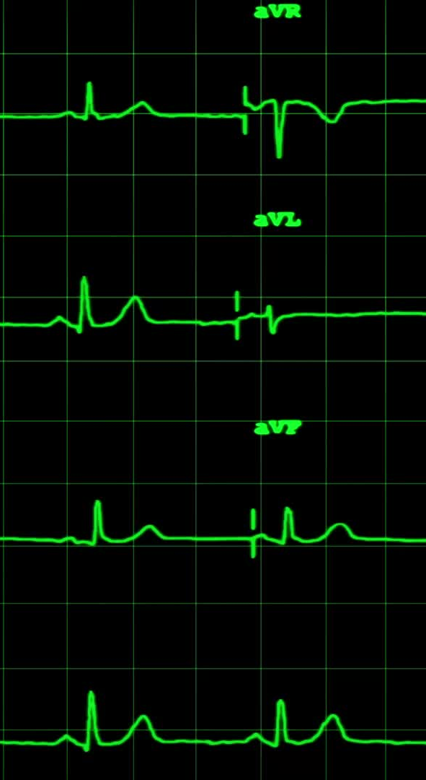
Cross-Validated Metrics:
Cross-validation is performed to obtain more robust estimates of the model's performance.
The cross_val_score() function from the sklearn library is used to compute cross-validated scores for accuracy, precision, recall, and F1-score.
The mean values of these metrics across different folds of cross-validation are calculated and stored in the cv_metrics DataFrame.
The cross-validated metrics are visualized as a bar plot to compare the model's performance across different evaluation metrics.

Slide 29
FEATURE IMPORTANCE AND SAVING MODEL:
The coefficients of the Logistic Regression model (G_log) are accessed using the coef_ attribute and stored in the fmatrix variable.
A dictionary named feature_dict is created to map each feature to its corresponding coefficient value using the zip() function.
This dictionary contains the feature names as keys and their corresponding coefficient values as values.

Slide 30

Creating a DataFrame for Feature Importance (Continued):
The feature_dict dictionary is used to create a DataFrame named features_imp.
This DataFrame contains the feature names as the index and their corresponding coefficient values as the columns.

Slide 31

Visualizing Feature Importance (Continued):
The feature importance is visualized using a bar plot, similar to the previous step.
The DataFrame features_imp is transposed (.T) to switch the rows and columns so that features are plotted on the x-axis.
The plot.bar() function is used to create a bar plot of feature importance, and the legend is disabled (legend=False).
The title of the plot is set to "Feature Importance".

Slide 32

Saving and Loading the Trained Model:
The trained Logistic Regression model (G_log) is serialized and saved to a file named "heart-disease-model.pkl" using the pickle.dump() function.
This allows the trained model to be reused later without the need for retraining.
The saved model is then loaded back into memory using the pickle.load() function and stored in the variable model.

Slide 33

Model Evaluation:
The loaded model (model) is used to make predictions on the test set (X_test), and the accuracy score of the model is calculated using the score() function.
This provides an assessment of the model's performance on unseen data.

